Slide 1


Resources as a Service (RaaS)

Slide 2
Overview
Context: a telecommunication network allows nodes to share their data through direct or indirect connections. The network is composed of different networking hardwares such as gateways, routers, switches and devices. Each of them embeds computing power to perform data transmission. However, they are not always fully used, e.g. no data to be transmitted. Consequently, their resources are lost, in that they are not exploited.
Objective: this project enables the Resources as a Service: by monitoring their own resources, nodes (e.g. gateways) notify the network that they are not fully used and able to rent resources.
Incentive:
Nodes are rewarded for sharing their resources in RCoin (Resource Coin)
A minimum reward is set by the “Client Application” (i.e. application that requires resources) and can be balanced according to the efficiency of the nodes (computing power / energy)
RCoin can be used to buy Services (resources from other nodes, maintenance, energy, ...)
Problematics:
How to select nodes to execute the “Client Application”, unanimously
How to reward nodes for sharing their resources, unanimously and securely
How to ensure that nodes have actually enough RCoin to access to services
How to ensure the correctness of a node computation (results)
How to verify that a node has actually shared its resources (fake computation)
How to measure the effiency of the nodes (computing power / energy) and the reliability of nodes (Error Rate)
How to avoid misbehaviour/malicious “Client Application”
How to avoid misbehaviour/malicious of nodes
Assumptions:
All identifiers are immutable and cannot be forged

Slide 3
Account & Resources Monitoring
Account: represent a complete identity of user on the network.
Account
Owner ID
Unique Owner Identifier
RCoin
Owner’s Rcoin Quantity
List of Nodes
List of nodes belonging to Owner
State
Fingerprint of the Owner’s Account
Resources Monitoring: list of node resources that can be evaluated
Categories | Metrics | Description
System | CPU | CPU load
 | RAM | RAM utilization
 | Disk | Remaining Storage Space
Network | Connections | Ethernet, WiFi, LoRa, BLE …
 | RSSI | Signal Quality (Wireless)
 | Bandwidth | Available throughput
Energy | Consumption | Average energy consumption
 | Battery Life | Remaining Energy (battery only)
Reliability | Error Rate | Bad Results rate
 | RCoin | RCoins quantity

Slide 4
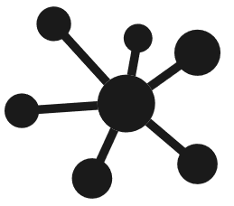

Account Creation
Account Creation
Multicast - 224.168.0.1
NewAccount | Owner ID
Account Synchronisation
NewAccount | Owner A
NewAccount | Owner B
Account
Account
Account
Account
Owner A
Owner B
Owner C
Owner D
5
Sign up bonus
5
5
5
{}
Empty list of Nodes
{}
{}
{}
000000
Genesis State
000000
000000
000000
Account A
Account A
Account A
Account A
Account B
Account B
Account B
Account B
Account C
Account C
Account C
Account C
Account D
Account D
Account D
Account D

Slide 5
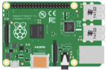
Add Node
Add Node
Multicast - 224.168.0.1
AddNode | Owner ID | Node ID | State
AddNode | Owner A | Pi1 | 000000
AddNode | Owner A | Pi1 | 000000
AddNode | Owner A | Pi1 | 000000
Node ID: Pi1
Node ID: Pi2
Node ID: Pi3
Node ID: Pi4
Account
Account
Account
Account
Owner A
Owner B
Owner C
Owner D
5
Add Node bonus
5
10
5
10
10
5
10
{}
Update list of Nodes
{}
Pi1
{}
Pi3
{}
Pi2
Pi4
000000
Update State
000000
578E6F
000000
357962
000000
2DF5F1
B3BB27
Account A
Account A
Account A
Account A
Account B
Account B
Account B
Account B
Account C
Account C
Account C
Account C
Account D
Account D
Account D
Account D

Slide 6
Add Application
Add Application
Multicast - 224.168.0.1
AddApp | Owner ID | Application ID | State
AddApp | Owner A | App 1 | 578E6F
AddApp | Owner A | App 1 | 578E6F
AddApp | Owner A | App 1 | 578E6F
Node ID: Pi1
Node ID: Pi2
Node ID: Pi3
Node ID: Pi4
Account
Account
Account
Account
Owner A
Owner B
Owner C
Owner D
10
10
10
10
Pi1
Pi2
Pi3
Pi4
578E6F
357962
04E4FE
2DF5F1
B3BB27
Account A
Account A
Account A
Account A
Account B
Account B
Account B
Account B
Account C
Account C
Account C
Account C
Account D
Account D
Account D
Account D

Slide 7
Application Request
Application Request
Multicast - 224.168.0.1
AppRQST | Requester ID | Application ID | Index
AppRQST | Owner A | App 1 | 2
AppRQST | Owner A | App 1 | 2
AppRQST | Owner A | App 1 | 2
Node ID: Pi1
Node ID: Pi2
Node ID: Pi3
Node ID: Pi4
Account
Account
Account
Account
Owner A
Owner B
Owner C
Owner D
10
10
10
10
Pi1
Pi2
Pi3
Pi4
1
1
1
1
Account A
Account A
Account A
Account A
Account B
Account B
Account B
Account B
Account C
Account C
Account C
Account C
Account D
Account D
Account D
Account D

Slide 8
Mapping Protocol – Add Peer List
Connection Detected
Add to Peer List
No
In Peer List ?
Yes

Slide 9
Mapping Protocol – Check Peer List
Wait Time Period
Try to connect with Peer
Next Peer
No
Change ?
Connected/Available <--> Disconnected/Not Available
Yes
Update Peer List
Remove from Peer List
Add to Peer List
No
Update ?
Yes
Send Updated Peer List

Slide 10
2. Network Mapping
Mapping
IP: 192.168.0.101
Mapping Flag | Peer ID | Peer List
PeerList
IP: 192.168.0.102
PeerList
PeerList
Mapping Flag | 100 | 101, 104
Mapping Flag | 100 | 101, 104
IP: 192.168.0.100
PeerList
IP: 192.168.0.103
Peer | Peer List
100 | 101, 104
101 | 100, 102, 104
102 | 101, 103
103 | 102, 104
104 | 100, 101, 103
PeerList
IP: 192.168.0.104

Slide 11
2. Send Peer Info
Peer Info (Consensus [224.168.0.1] - Multicast)
IP: 192.168.0.101
ClientRQST | Position | Status
ClientRQST | 43.000 / 3.800 | 000000
PeerList
Every x seconds
PeerList
PeerList
IP: 192.168.0.100
IP: 192.168.0.102
Peer | Position | Status
192.168.0.100 | 43.637 / 3.840 | 000000
192.168.0.101 | 44.637 / 4.840 | 000000
192.168.0.102 | 45.637 / 5.840 | 000000
192.168.0.103 | 46.637 / 6.840 | 000000
PeerList
IP: 192.168.0.103

Slide 12

3. Client Request
Client Request (Consensus [224.168.0.1] - Multicast)
IP: 192.168.0.101
ClientRQST | Position
ClientRQST | 43.000 / 3.800
PeerList
Client 1
PeerList
PeerList
IP: 192.168.0.100
IP: 192.168.0.102
Peer | Position | Status
192.168.0.100 | 43.637 / 3.840 | 000000
192.168.0.101 | 44.637 / 4.840 | 000000
192.168.0.102 | 45.637 / 5.840 | 000000
192.168.0.103 | 46.637 / 6.840 | 000000
PeerList
IP: 192.168.0.103

Slide 13
4. Consensus – Find Free Peers
Client Request (Consensus [224.168.0.1] - Multicast)
IP: 192.168.0.101
Client 1
ClientRQST | Position | Status
ClientRQST | 43.000 / 3.800 | A2E561
PeerList
Peer | Position | Status | Peer -> Client
192.168.0.100 | 43.637 / 3.840 | 000000
192.168.0.101 | 44.637 / 4.840 | 000000
192.168.0.102 | 45.637 / 5.840 | 000000
192.168.0.103 | 46.637 / 6.840 | 000000
PeerList
PeerList
IP: 192.168.0.100
= Free
IP: 192.168.0.102
Peer | Position | Status
192.168.0.100 | 43.637 / 3.840 | 000000
192.168.0.101 | 44.637 / 4.840 | 000000
192.168.0.102 | 45.637 / 5.840 | 000000
192.168.0.103 | 46.637 / 6.840 | 000000
PeerList
IP: 192.168.0.103

Slide 14
4. Consensus – Find Closest Peers
Client Request (Consensus [224.168.0.1] - Multicast)
IP: 192.168.0.101
Client 1
ClientRQST | Position | Status
ClientRQST | 43.000 / 3.800 | A2E561
PeerList
Peer | Position | Status | Peer -> Client
192.168.0.100 | 43.637 / 3.840 | 000000 | 0.637 / 0.040
192.168.0.101 | 44.637 / 4.840 | 000000 | 1.637 / 1.04
192.168.0.102 | 45.637 / 5.840 | 000000 | 2.637 / 2.04
192.168.0.103 | 46.637 / 6.840 | 000000 | 3.637 / 3.04
PeerList
PeerList
IP: 192.168.0.100
= Free
Closest
IP: 192.168.0.102
Peer | Position | Status
192.168.0.100 | 43.637 / 3.840 | 000000
192.168.0.101 | 44.637 / 4.840 | 000000
192.168.0.102 | 45.637 / 5.840 | 000000
192.168.0.103 | 46.637 / 6.840 | 000000
PeerList
IP: 192.168.0.103

Slide 15
4. Consensus – Send New Peer Info
Client Request (Consensus [224.168.0.1] - Multicast)
IP: 192.168.0.101
Client 1
ClientRQST | Position | Status
ClientRQST | 43.000 / 3.800 | A2E561
PeerList
Peer Info (Consensus [224.168.0.1] - Multicast)
PeerInfo | Position | Status
PeerInfo | 43.637 / 3.840 | A2E561
PeerList
PeerList
IP: 192.168.0.100
IP: 192.168.0.102
Peer | Position | Status
192.168.0.100 | 43.637 / 3.840 | A2E561
192.168.0.101 | 44.637 / 4.840 | 000000
192.168.0.102 | 45.637 / 5.840 | 000000
192.168.0.103 | 46.637 / 6.840 | 000000
PeerList
IP: 192.168.0.103

Slide 16
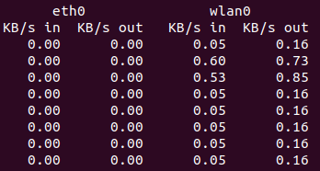
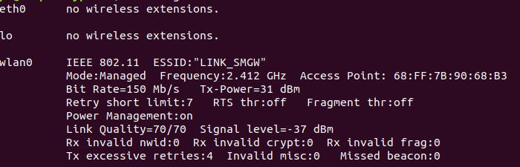
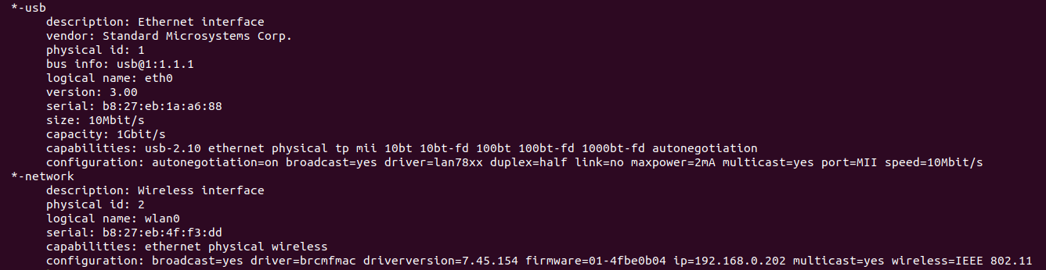
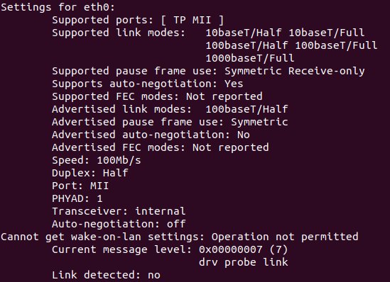
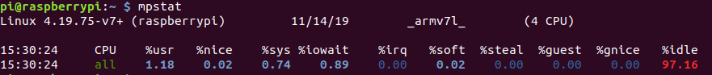
Relaying Protocols
sudo apt-get install ifstat
iwconfig (wireless only, can change configuration !)
sudo lshw -class network
sudo apt-get install ethtool
ethtool eth0

Slide 17
Overview
Context: a telecommunication network allows nodes to share their data through direct or indirect connections. The network is composed of different networking hardwares such as gateways, routers, switches and devices. Each of them embeds computing power to perform data transmission. However, they are not always fully used, e.g. no data to be transmitted. Consequently, their resources are lost, in that they are not exploited.
Objective: this project enables the Resources as a Service: by monitoring their own resources, nodes (e.g. gateways) notify the network that they are not fully used and able to rent resources.
Incentive:
Nodes are rewarded for sharing their resources in RCoin (Resource Coin)
A minimum reward is set by the “Client Application” (i.e. application that requires resources) and can be balanced according to the efficiency of the nodes (computing power / energy)
RCoin can be used to buy Services (resources from other nodes, maintenance, energy, ...)
Problematics:
How to select nodes to execute the “Client Application”, unanimously
How to reward nodes for sharing their resources, unanimously and securely
How to ensure that nodes have actually enough RCoin to access to services
How to ensure the correctness of a node computation (results)
How to verify that a node has actually shared its resources (fake computation)
How to measure the effiency of the nodes (computing power / energy)
How to avoid misbehaviour/malicious “Client Application”:
Code has to be validated (human verification)
Every operators in the code has a price (e.g. gas in Ethereum, to avoid infinite loop)
Owner of the node is himself in charge of accept the deployment of the “Client Application” into his nodes
Check Client request to avoid client’s misbehaviour (Black list)

